Slide 1
PERSONAL MEDICINE REMINDER APP
Team 21 :
Anandhi D L
Anjana Balachandran
Athira M S
Devika A R
Gauri Revikumar
Manjima A T
Sivadarsana Unni

Slide 2
CONTENTS
Introduction
Problem Statement
Proposed Solution
Proposed System
Working
Demo Video
Contributions of the team members
Conclusion

Slide 3
INTRODUCTION
Human life expectancy has been enhanced due to advances in medicine.
In modern society,busy life has made people forget many things in day to day life.
Sometimes patients forget to take the medicine at the required time of medicines.
If right medicines are taken at right time there are less chances that the condition of a patient getting worse.

Slide 4
PROBLEM STATEMENT
Most of the patients, especially tends to forget the correct time for their medicine intake.
It is very difficult for a physician to continuously remind the patient about the importance of taking medicine at correct time.
Failure in correct timing for medicine intake cause severe negative impacts.

Slide 5
PROPOSED SOLUTION
This system is developed, keeping in mind the problems of every user have no more time to take care of their health. To avoid that problem, we have built this application and user can access it anywhere and anytime.
Medication reminder app supports user to feel confident with appropriate handling and administering of medication.

Slide 6
PROPOSED SYSTEM
An application, which helps user to take medicine on correct time
Unique username and password for user
Check if it is the correct time for a user to take medicine
Utilization of speech commands

Slide 7
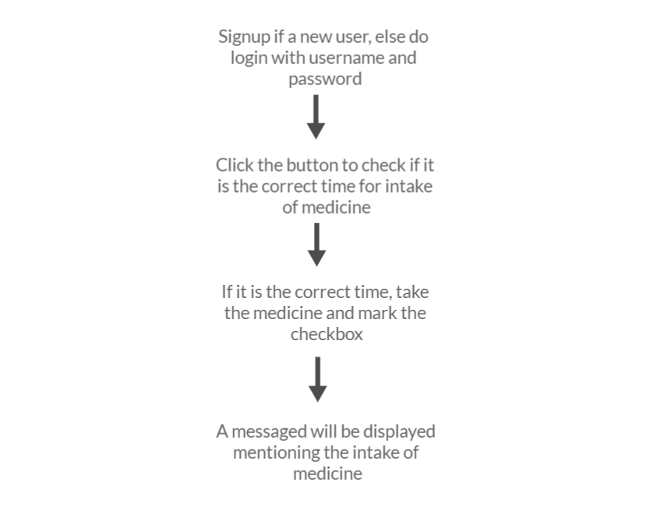
WORKING

Slide 8
DEMO VIDEO
Demonstration :

Slide 9
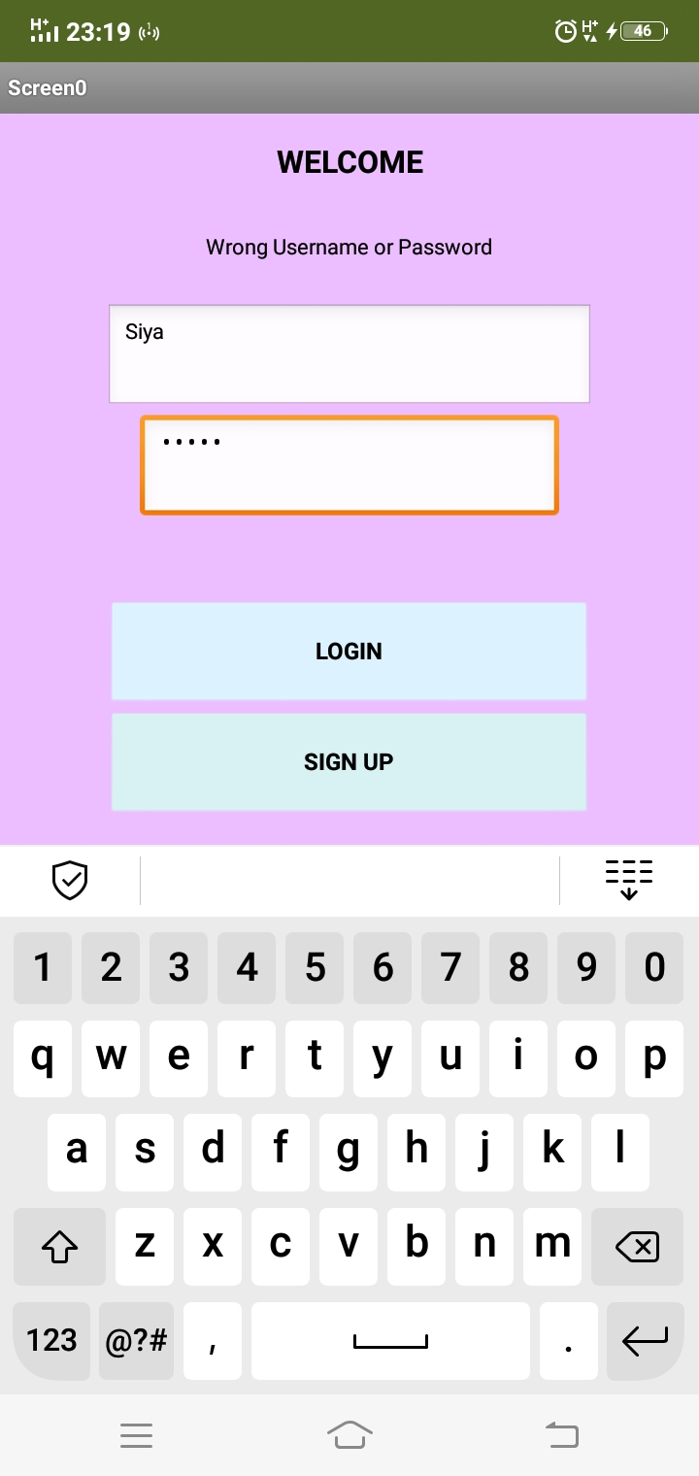
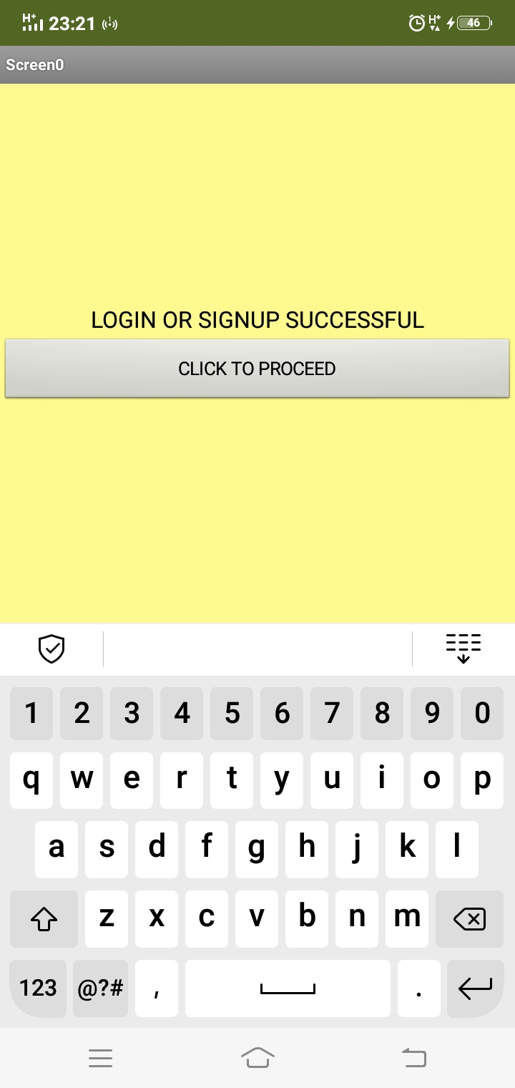

Slide 10
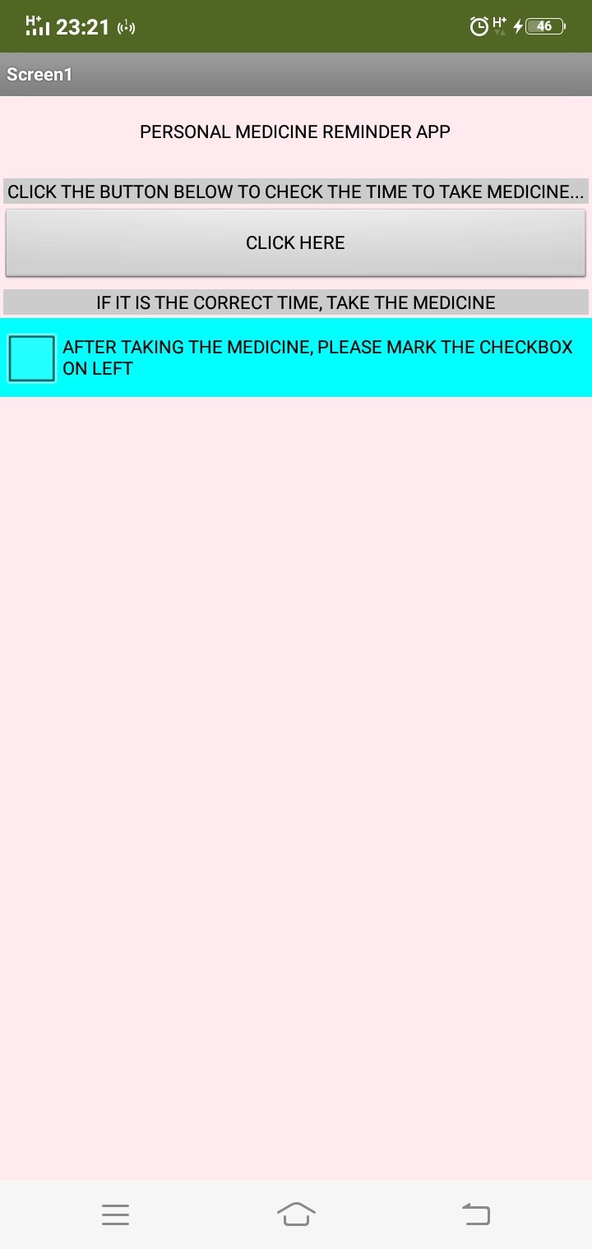
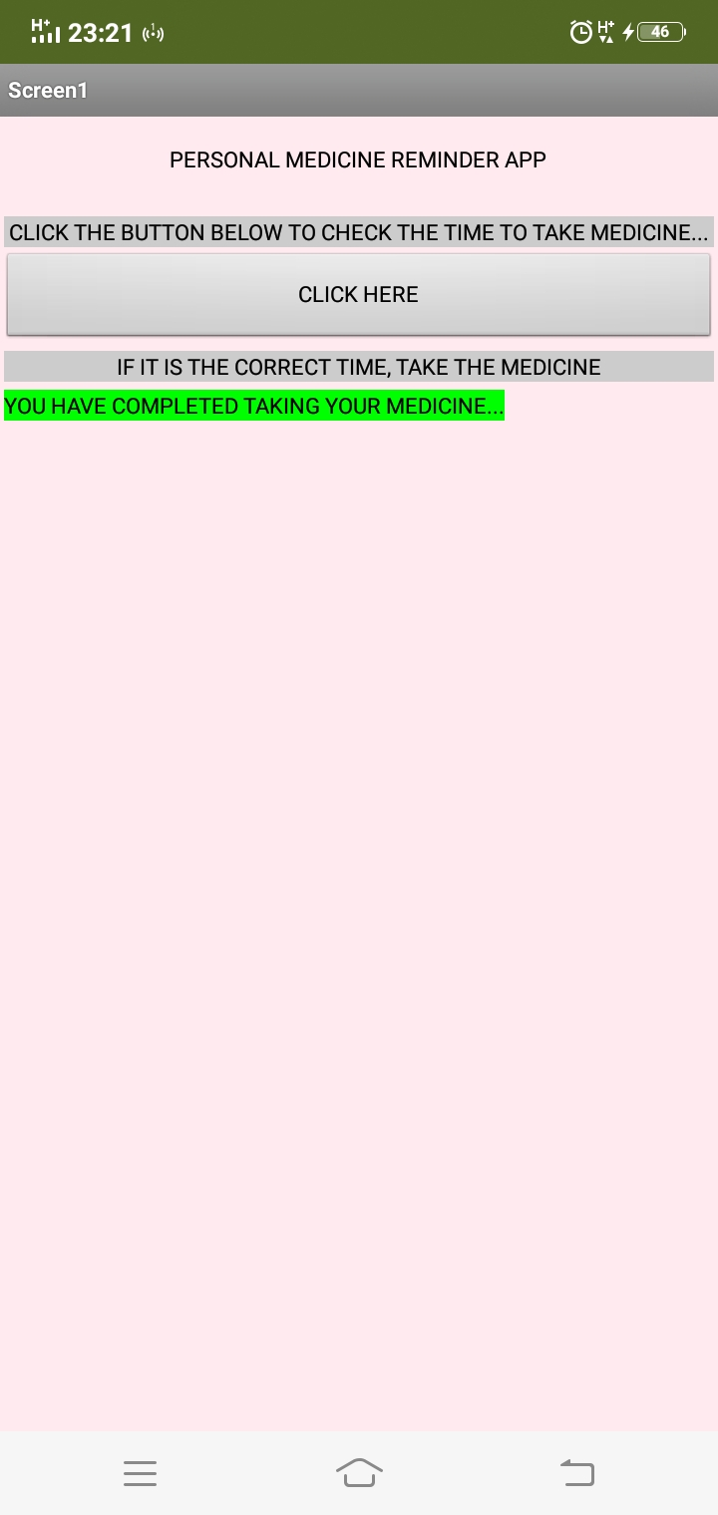

Slide 11
CONTRIBUTIONS OF THE TEAM MEMBERS
Anandhi D L - Analysis of problem statement and solution
Anjana Balachandran - Identification and analysis of problem statement, documentation
Athira M S - Identification and analysis of problem statement
Devika A R - Identification and analysis of problem statement, analysis of solution
Gauri Revikumar - Identification and analysis of problem statement, documentation
Manjima A T - Analysis of problem statement and solution, documentation
Sivadarsana Unni - Coding, identification and analysis of problem statement, analysis of solution, documentation

Slide 12
CONCLUSION
The medicine remainder will be very helpful to many patient.
It helps to take proper medicine at right time.
It provides flexibility to accommodate future needs.

Slide 13
THANK YOU

